Slide 1
12/1/14 Agenda
Floral I – Review Unit 10, 11, 12, & 13
See’s Candy Money Due Today!!!!
Inverted – T Portfolio Critique Due
Return Floral Containers for Points
Quiz 10,11,12,13 Friday
Floral II – FBTM Demo and build
Record Books and thanksgiving critiques
Floral II – Holiday Design Plan Final

Slide 2
Unit 10, 11, 12, 13 Review
List circular, triangular & Line arrangements.
When would you use a circular arrangement?
How tall should an arrangement for a table be? Why?
How is rhythm used in a arrangement?
List 3 possible uses for a triangle design.
What does your eye do when you look at a vertical line arrangement?
What is negative space?
How do you make or create the curve appearance in a crescent or S-curve arrangement?
Explain two benefits of a vertical arrangement.
What are the characteristics of the contemporary free style design?

Slide 3
Unit 10 – 13 Quiz Word Bank mhepner@tusd.net – Send Wreath Pic.
Mass Arrangements
Cone
Mound
Fan
Oval
Triangle Arrangements
Equilateral Triangle
Right Triangle
Isosceles Triangle
Asymmetrical Triangle
Scalene Triangle
Line Arrangements
Vertical
L – Arrangement
Inverted –T
Horizontal
Diagonal
Line-Mass Arrangements
Hogarth Curve
Crescent design

Slide 4
Sem.1 Study Guide
Unit 1
Identify the jobs available in the retail flower business
Describe the duties of various jobs in the retail florist business
Identify the different types of florist
Unit 2
List and define the floral history periods
List and define design principals
List and define design elements
List basic designs used in flower arranging
List the basic color schemes used in floral design
Unit 7
Describe how to make a bow
Unit 10
Identify 4 types of circular mass arrangements
List basic steps to create a mass arrangement

Slide 5
Semester 1 Study Guide part 2
Unit 11
Identify the 6 different types of triangular arrangements
Distinguish the difference among triangular arrangements
List basic steps to create a triangle arrangement
Unit 12
Identify the 6 different kinds of line arrangements
Distinguish the difference among the line arrangements
List basic steps to create a line arrangement
Define Negative Space
Unit 13
List the different colors relating to 5 popular holidays
List the different flowers associated with 5 popular holidays
Identify Major Holidays and the Dates associated with those holidays

Slide 6
12/2/15 Agenda
Floral I – Review Unit 10, 11, 12, & 13
See’s Candy Money past due!!!!
Inverted – T Portfolio Critique Past due
Return Floral Containers for Points
Quiz 10,11,12,13 next Thursday – 10th
Wreath Design Plan
Floral II – FBTM Processing
Record Books and thanksgiving critiques
Floral II – Holiday Design Plan Final

Slide 7
Dec. Assignment Calendar
All – FFA Meeting – 12-16 @ 12:35
Floral I - 3&4 Bow Practice
3 - Quiz and notes due
2-3 Design Plan - Wreath
10-12– Evergreen Wreath/Bows
9-10 - Final Review
16-18 Finals/Mini Day & Assignment
Floral II
2-3 FBTM make and delivery
5-9 Record Books and HMF
10 – Process flowers
15 and 16- Holiday Sale Arrangements - Final
17– Personal Arrangement

Slide 8
December FBTM
Round/Mound Shape
Container with Oasis –re-wet foam
5 red carnations
1 stem button mum – Green
1 stem button mum – White

Slide 9
Evergreen Wreath Design Plan
How will you plan to use your Wreath?
Wreath Shape
Use Options
Color Drawing of wreath and decorations
List Materials with Quantity of each item
Bow
Quantities of Decorations
berries, cones, ribbon, etc
List Color Scheme
Explain Shape and Focal Point

Slide 10
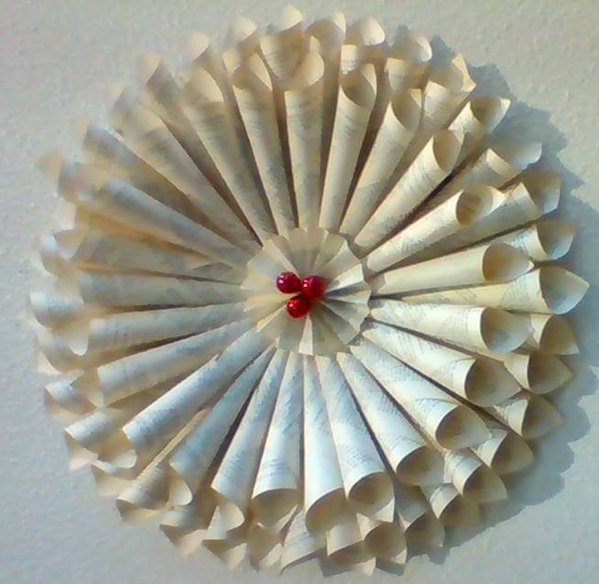
S. Perry, WHS Librarian: Book Art

Slide 11
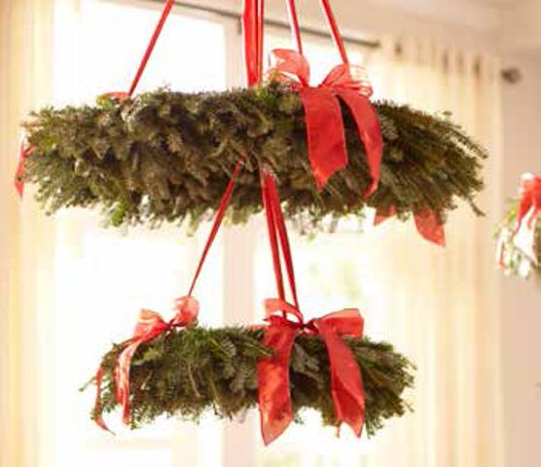
Home Depot Wreath Chandelier

Slide 12
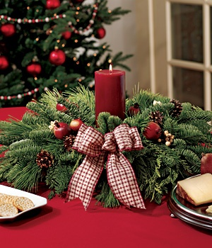
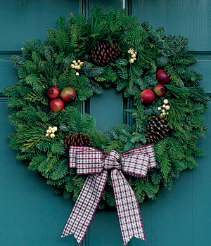
Wreath Ideas

Slide 13
12/3/15 Agenda
Floral I – Wreath Design Plan Due
Bow Construction – Tray and Floral Shears
Get 1 Piece of Wire (24 Gauge)
Cut a Piece of Ribbon 24 inches long
Tape Wire & wait for directions – New Challenge
Floral II –Review resume/cover letter/ etc.
Holiday Material Order Due Tuesday (today)
Friday - Last Day to turn in Late Work!

Slide 14
12/4/15 Agenda
Floral I – Wreath Design Plan Due
Wreath Form Construction
Tray and Wire Cutters
Floral Tape
Name Tag
Bow Construction – Tray and Floral Shears
Get 1 Piece of Wire (24 Gauge)
Cut a Piece of Ribbon 24 inches long
Tape Wire & wait for directions – New Challenge
Floral II –Review resume/cover letter/ etc.
Holiday Material Order Due Tuesday (today)
Friday - Last Day to turn in Late Work!

Slide 15
Evergreen Wreath
Safety – Bending Wire with Pliers
Floral Shears/Pruning Shears/Wire Cutters
Size & Shape of Wreath
Shape Wreath before cutting.
A Smaller Wreath is done more quickly.
Cut Wire Hanger to Size you want.
Small Hook at both ends of wire.
Interlock Hooks and Crimp to Secure Shape.
Cover Wire Totally with Green Floral Tape.
Attach Paddle Wire to Form & Use to attach Greenery to Wreath Form
Cut Greenery is similar sized pieces

Slide 16
Bow Construction
Purpose – Accessory to Complete a Design like a wreath
Materials – Ribbon, Tape & Wire
Design Concerns
Scale and Proportion
Texture
Width
Color
Event and Current Trends

Slide 17
12/11/15 Agenda
Floral I –Unit 10, 11, 12, & 13 Quiz
Get out notes and writing utensil
Individual Quiz
Evergreen Wreath Critique – due today
Art Elements – written definition and Doodles – Finish & check on monday
Floral II – FBTM
EH: Quad boxes – Fill in Ivy and Iris

Slide 18
12/4/14 Agenda
Floral I –Unit 10, 11, 12, & 13 Quiz Friday
Art Elements – Doodles
Chapter 2 – Design practice
Get out Text Book, definitions, sketch/doodle of terms
10-13 Quiz Review
Check Flower Press
Floral II – FBTM Critiques

Slide 19
12/7/15 Agenda
All – FFA Meeting, Wednesday the 16th @12:35
All – Assignment Due Final Day is Friday
Review of Final Study Guide on your own
Floral I & II- Evergreen Wreath Project - Demo
Need to make up Quiz? Be Here at lunch!
Floral II – Customer Arrangements - Final
Portfolio Critiques
Record Books

Slide 20
Design Principals & Elements
Asymmetrical Symmetrical
Proportion Focal Point
Repetition Radiation
Progression Transition
Unity Line
Form Texture

Slide 21
12/8/15 Agenda
All – FFA Meeting, Wednesday the 16th @12:35
All – Assignment Due Final Day is Friday
Review of Final Study Guide on your own
Need to make up Quiz? Be Here at lunch!
Floral I & II- Evergreen Wreath Project –
Get Pruning Shears and Go cut Tree Material
Get Paddle wire, attach it and starting adding tree material.
Pull firmly on the paddle each time around.
Floral II – Customer Arrangements - Final
Portfolio Critiques
Record Books

Slide 22
12/8/15 Agenda
Floral I & II- Evergreen Wreath Project –
Get Pruning Shears
Go cut to Tree and carefully cut Material
Cut Tree materials to same size and shape
Get Paddle wire, attach it and starting adding tree material.
Pull firmly on the paddle each time around.

Slide 23
11/29/12 Agenda
Floral I-
Floral II – Design Plan for Holiday Arrangement
FBTM Design Plan
See’s Orders and Poinsettias deposits

Slide 24
Brain Teaser - Darkness Phobia
One family wants to get through a tunnel. Dad can make it in 1 minute, mama in 2 minutes, son in 4 and daughter in 5 minutes.
Unfortunately, not more than two persons can go through the narrow tunnel at one time, moving at the speed of the slower one.
Can they all make it to the other side if they have a torch that lasts only 12 minutes and they are afraid of the dark?
Dark Phobia - solution First mom and dad – 2 minutes. Dad comes back – 3 minutes, both children go to mom – 8 minutes. Mom comes to dad – 10 minutes and they both get to their children – 12 minutes.

Slide 25
Garden Final Study Guide
Landscape Maintenance
Landscape Architect
Landscape Contractor
Landscape Gardner/ Maintenance
Landscape Nurseryman
Fertilizer
Installing Landscape Tools
Weeds – How they reproduce
Native Species Plants - Benefits

Slide 26
11/16/10 Agenda EXC
Floral I – Preparing Symmetrical Arr.
Read Packet
Answer Worksheet
Turn in Both to teacher at the end of period
Tomorrow - Make 3-D Wire Arrange.
Definitions from Next slide to notes
Floral II – HMF

Slide 27
12/3/12 Agenda
All - Friday - Last Day to turn in Late Work!
Floral I – Hand Out Study Guide
Floral I– Design Plan Due tomorrow in basket
Evergreen Wreath Project start Tuesday
Floral II –Review resume/cover letter/ etc.
FBTM
Holiday FSS order

Slide 28
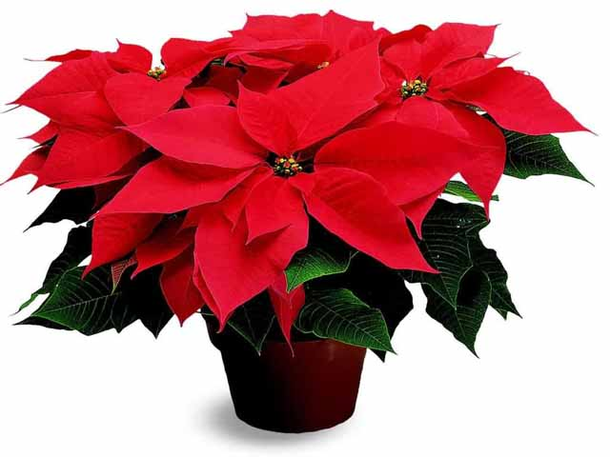
Poinsettia Sale
Merrill F. West FFA
Annual Fundraiser
$ 10.00 /plant
Presale Begins: NOW
Arrival Date: December 4

Slide 29
12/10&11/13 Agenda
Friday - Last Day to turn in Late Work!
Floral I – Study Guide & Final Review
Unit 10, 11, 12, 13 Quiz Review
Bow on Friday
Wreath Design Plan
Bow Practice – Tray and Floral Shears
Get 1 Piece of Wire (24 Gauge)
Cut a Piece of Ribbon 24 inches long
Tape Wire & wait for directions
Floral II –Present Career Report
Grade Quiz & Letter to Govenor

Slide 30
Winter Holiday Design Plan
Color Drawing of Wreath & Accessories
List Materials & Quantity of each item
Berries - Color
Pine Cones - Color
Bow – Color and Placement
List Color Scheme and Use
Explain Shape, Size & Focal Point

Slide 31
12/14/15 Agenda
Friday is the last day to turn in late work
Floral I- Final Day
M/C & T/F Scantron on Wed-Friday
Bow Practice final
Principals and Elements of ART pg 19-29
Define Terms in writing and with sketch
Floral II
Personal Holiday Arrangements - Process
Final - Fill Orders for paying Customers

Slide 32
Design Principals & Elements
Asymmetrical Symmetrical
Proportion Focal Point
Repetition Radiation
Progression Transition
Unity Line
Form Texture

Slide 33
Focal Point Repetition/Radiation/Unity

Slide 34
Unity/Asymmetrical/Radiation

Slide 35
Asymmetrical/Transition/Texture

Slide 36
12/15/15 Agenda
All – Last day to turn in late work
Floral I – Bow Final
See Rubric
Floral II – Process Holiday Flowers

Slide 37
Finals Week |  |  |  | Monday – 1:25
Schedule |  |  |  | Tuesday – 2:50
 |  |  |  | Wed. Dec. 17th |  | Thurs. Dec. 18th |  | Friday Dec. 19th
Passing Period: |  |  |  | 7:44 - 7:50 |  | 7:44 -7:50 |  | 7:44 - 7:50
FINALS |  |  |  | Period 1 |  | Period 3 |  | Period 5
 |  |  |  | 7:50-10:00 |  | 7:50-10:00 |  | 7:50-10:00
Passing Period |  |  |  | 10:00-10:10 |  | 10:00-10:10 |  | 10:00-10:10
FINALS |  |  |  | Period 2 |  | Period 4 |  | Period 6
 |  |  |  | 10:10-12:20 |  | 10:10-12:20 |  | 10:10-12:20
Dismissal |  |  |  | 12:20 |  | 12:20 |  | 12:20

Slide 38
12/16-18/15 Agenda
Finals - Minimum Day
Period 2 – personal centerpieces
Period 1, 3, 5, 6 – Final
Prepare – Clear Table
#2 pencil out
No Notes
Bow after all finals are done

Slide 39
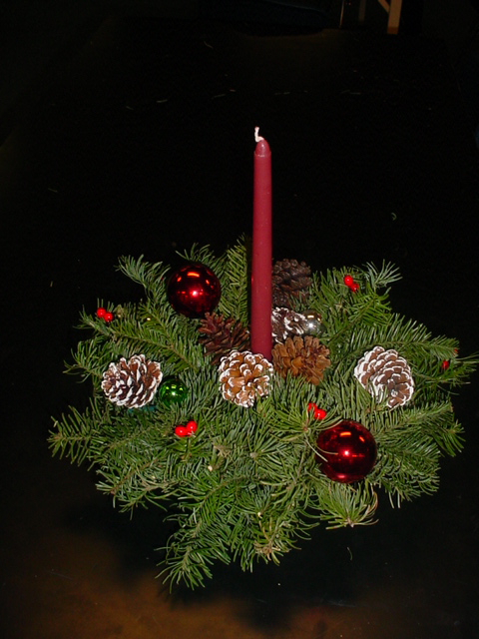
Holiday Arrangement Floral II Final

Slide 40
Floriculture I Semester 1 Final Bow Rubric (25 points)
A Grade (22-25) Must have All parts of ‘B’ plus:
More than 2 loops with equal amount of loops on each side
All loops should move individually (wire is tight)
A Tail is extra points
B Grade (20-21) Must have:
Center loop
Correct ribbon side out
2 loops (one per side)
Taped wire
Bow must be symmetrical
No Double bows

Slide 41
Floriculture I Semester 1 Final Bow Rubric (25 points)
C Grade (17-19) Will have:
All parts of B Grade with one flaw from below:
No tape
Incorrect side showing
Fewer loops
Unequal loop amounts per side
Bow is not symmetrical
D Grade (15-17) Will have:
2 or more flaws from C Grade list
F Grade (0):
Student did not make a bow at all

Slide 42
12/12 -14/13 Agenda
Finals - Minimum Day
Period 1 – personal centerpieces
Period 2, 3, 5, 6 – Ever
Turn in Study Guide to Basket
Prepare for Final – Clear Table
You need a SSR Book and Pencil
Bow Portion of Final will be after everyone is done with written final.

Slide 43
Holiday Card To a Soldier
Please make your card out to;
American Red Cross
c/o Walter Reed Army Medical Center
6900 Georgia Avenue NW Room 3E05
Washington, DC 20307-5001

