Slide 1
1. Floral I
2. Floral II
Environmental Hort.
Objectives:

Slide 2
Welcome to Back to School Night
Mrs. Hepner 's Floriculture/Ag. Earth Class
Introduction
Agenda & Syllabus
Aries Sign up
Upcoming FFA Events
  8-26 FFA Meeting in Theater @ 3:15pm
  9-11 Kid in a Box @ St. Bernard's
  9-16 FFA Meeting in Theater @ 3:15pm
  9-30 Delta Cal Opening Closing contest
  10-8 Greenhand Conference
  10-10 Fall Festival
  10-21 FFA Meeting in Theater @ 3:15
  November - Poinsettia & See’s Pre-Sale

Slide 3
Welcome!
Teacher: Mrs. Hepner
Period 1: Floriculture I
Period 2: Floriculture II & Environmental Hort.
Period 3: Agriculture Earth Science
Period 4: Prep
Period 5: Floriculture I
Period 6: Floriculture I
All Classes: Report to P-12
Classroom on North Side of Campus past quad

Slide 4
Welcome!
1. Sign In on the sheet @ the 1st table 2. Select any seat, chairs stay in place
Teacher: Mrs. Hepner
Classroom: P-12
Period 1: Floriculture I
Period 2: Floriculture II & Environmental Hort.
Period 3: Agriculture Earth Science
Period 5: Floriculture I
Period 6: Floriculture I

Slide 5
Lunch Schedule
1st lunch – MS, H, Trailer 1-6, & Theater
2nd Lunch – P, T-21, PE, K and G

Slide 6
Floral I
Floral II & Environmental Horticulture
Agriculture Earth Science
1. Find your name on class roster and sign in the column for todays date. If your name is not listed, write it in on an empty line.
2. Find a seat at a table that has no more than 3 people who are your same grade.
4. Get out writing tool and note paper.
5. Introduce yourself to your table mates and write down 3 different facts about Agriculture.
Objective: Meet People 8-11-15

Slide 7
Floral I
Floral II
Environmental Horticulture
1. Find your name on class roster and sign in the column for todays date. If your name is not listed, write it in on an empty line.
2. Find a seat at a table that has no more than 3 people who are your NOT your same grade.
3. Get out writing tool and note paper.
4. Introduce yourself to your table mates and write down 3 facts about each one.
Objective: Meet People 8-12-14

Slide 8
8/11/15 Agenda
Student Sign In & Meet Table Mates
Teacher Introduction
Name Card: Due 8-14-15 at the beginning of class
Side A: Name, Period and Photo
Real Contact Info!!
Side B: 1 thing you hope happens /you learn for this year.
A Goal you have for 2 years from now for yourself.
5 Cool Things About Yourself include hobbies or interests

Slide 9
8/11/15 Agenda
Locations: Paper Towels, Cleaning Tools
Recycling: Paper and Beverage Containers
Bathroom Pass and Sign Out
College & Scholarship Information
Tomorrow Bring a Tie – Extra Credit
Hand Shake: Eyes, Smiles, Web, Firm, 2-3 Shake
Find Someone; 3 siblings, 18, has dog, has horse, vacation out of state.
Judge a Class of Cut Flowers (I place this class of cut ______, 1,2,3,4..)
http://www.youtube.com/embed/_LpMB1OZ53g?feature=player_detailpage%22%20frameborder=%220%22%20allowfullscreen%3E%3C/iframe%3E&autoplay=1
Floral II: Arrange Room & Record Book Scavenger Hunt

Slide 10
ASB Calendar
August 17-21 Rush Week (during lunches)
September 7-Labor Day No School
4 – Rally and Game WHS vs KHS
15th Spirit Workshop
21-25 Homecoming Week
22 Powder Puff
23 Night Rally
25 Parade, WHS vs Bear Creek and Dance
October 9-Football vs. St. Mary’s
19 – Brest Cancer Support Week
20 Spirit Workshop
23 Pink out West vs Lodi
30 WHS vs Tokay

Slide 11
ASB Calendar
November 2nd -6th Spirit Week
6th –Rally & WHS vs Tracy Game
20-Multicultural Feast
30 WHS vs THS Foundation Basket Ball
December 5-Winter Ball
17-19-Finals Week
22-31 Winter Break

Slide 12


Slide 13
Floral II-Shop Day 1 & 2
Resume, Cover Letter & Job Application.
Lay out desks in 3 rows x 4 Deep, 3 Chairs each table
With Tape - Number Tables & student number
Place Chairs at tables (3), extras go against the wall
Hang Posters
Select Cabinet for Inventory Presentation
Check list on the door & compare what is in the cabinet & correct list as needed
Present your cabinet with 3 samples in your hand
Return all items to the cabinet.
Cabinet Inventory Presentation and Quiz tomorrow.

Slide 14
8/12/15 Agenda
All – Back to School Night Tonight
All – Sign In – New Buddy, New Names on List
Assignment Calendar - Dates, Holiday, Daily Assignments, Name, & Period
Tie A Tie, Symbol
All - Turn in name card Friday, 8-14-15
Syllabus Due on 14th
Build a Symbol/Brand/Trademark for you and Share
Floral I - Tie A Tie for Points
Name Page & Name Quiz due 8-14-15
Friday 14th– Check out Text books – Bring ID
Floral II – Name Card & Assignment Calendar
Floral Inventory presentation with New Signs Printed
Check list on the door & compare what is in the cabinet & correct list as needed
Present your cabinet with 3 samples in your hand 6. Return all items to the cabinet.
Cabinet Inventory Presentation and Quiz.

Slide 15
Floral II & EH Semester 1 Assignments
Hire Me First
Resume
Cover letter
Job application
Wedding portfolio critiques
FBTM flyer & design plan
FBTM critiques
September
October
November
December
Winter Holiday design plan
Winter Holiday portfolio critique
Record book
Calendars- May - December
Placement agreement
Journals May-December
FFA activities
Financial statements
Income summary
Budget
Participation points

Slide 16
Assignment Calendar
Dates, Holiday, Daily Assignments, Name, & Period
August - 31 days (start today the 11th)
Back to School Night – 13th
FFA Meeting – 20 @ 3:15 in P-12 for 10% of Grade
26-29th – Rush Week
September – 30 days (start on backside of sheet)
1 - Labor Day – Monday -No School
8th – Mini Day for District Teacher Welcome
12th – Fall Food Faire
FFA Meeting –17@ 3:15 in P-12 for 10% of Grade
Assignment Calendar: Due 10-4-13 (35 points)

Slide 17
8/13/15 Agenda
All - Sign in and Name List
All – Name Card, Syllabus due Fri.
All – Tie A Tie
All - Friday 14th– Check out Text books – Bring ID
All - Name Quiz next Friday
All – Introduction with a buddy.
Add to Name Page – write names on the board
Floral II & Environmental Hort –
  Select a buddy to work with – Inventory and Weed Report
  Select a Weed for your report
Introduction with a buddy.
Add to Name Page – write names on the board

Slide 18
8/14/15 Agenda
All - Sign in and warm up
All – Name Card, Syllabus due to basket
All - Name Quiz next Friday
All – Text book Pick up
All – Finish the Introduction with a buddy.
All – Last day to Tie a Tie
All – Bee’s in Agriculture – Ag Alert
Add to Name Page - Write names on the board
Floral II – Name Card & Syllabus due Friday
Floral Inventory presentation with Edit Signs and Printed
Check list on the door & compare what is in the cabinet & correct list as needed
Present your cabinet with 3 samples in your hand 6. Return all items to the cabinet.
Cabinet Inventory Presentation and Quiz Friday

Slide 19
Introduction Presentation
Find a Buddy to Introduce
  Name ( First & Last)
  Favorite Music Genre
  Favorite Ice Cream
  Best Summer Activity
  Family Description
  Dream College/after Graduation Plans and Why

Slide 20
8/14/14 Agenda
All – Sign in and warm up
All – Name Card, Syllabus and Name List due Fri.
Friday is Last Day - Tie A Tie for Points
Name Quiz on Friday
Monday 18h – Check out Text books – Bring ID
Mixer
Close Read - Water
Floral II – Resume & Cover Letter
Name Card & Name Quiz on Friday
Floral Inventory presentation with New Signs Printed
Check list on the door & compare what is in the cabinet & correct list as needed
Present your cabinet with 3 samples in your hand 6. Return all items to the cabinet.
Cabinet Inventory Presentation and Quiz on Friday

Slide 21
Syllabus Warm-Up/EC to be
Answers on your Name List/Quiz.
What is the best way for parents to get grade info?
What is the best way to contact Mrs. Hepner?
List 3 things you will learn about this year in class?
If you use bad word, what is your punishment?
What percent of your grade is classwork?
How often do you have homework in this class?
List 3 recommended materials for this class.
How much does each student cost in this class?
When is the syllabus due for full credit?

Slide 22
Inventory Quiz
1. Which cabinet has Winter Holiday stuff?
2. Which cabinet has cardets?
3. Which cabinet has ribbon & office supplies?
4. Which cabinet has spray paint?
5. Cleaning supplies can be found where?
6. Large vases can be found where?
7. Curling ribbon & balloons are where?
8. What is in cabinet # 3? 2 examples?
What is in cabinet # 4? 2 examples?

Slide 23
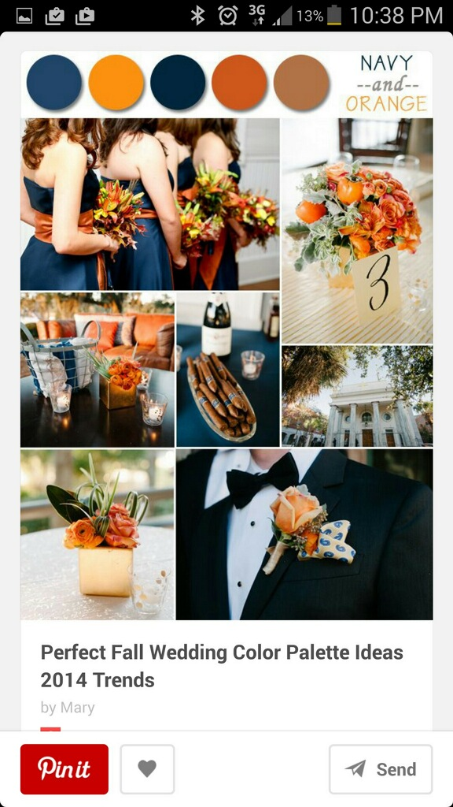
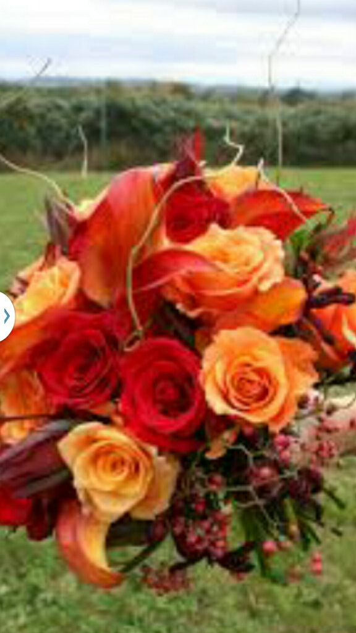

Slide 24
8/17/15 Agenda
All – Seating Chart – Find your Name Card
All - Agenda Log: Ag Challenge
All - New Horizon – table share Presentation
  Page 26 – How do you learn?
  List 3 facts to share about your learning method.
  cut and paste info into your note book.
Floral II – Hire Me First Profile ; hiremefirst.org
Resume & Inventory Cabinet Labels Typed
Resume and Cover letter review

Slide 25
Warm Up Guidelines
Write out question and answer
Write out each item of the agenda (Objective)
Notes may be used
Warm up questions are often test questions.

Slide 26

Agenda 8/17 Warm Up
Agriculture Group Challenge
Take out- pen/pencil, notebook or paper
How are Bees important to Agriculture?

Slide 27
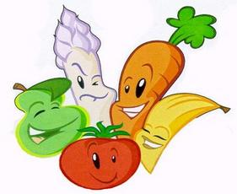
Agriculture Challenge
Today will serve as an introduction to topics in agriculture.
You be will learning some basics on crops and topics in agriculture while working with your lab groups

Slide 28
8/18-19/15 Agenda
All – Make Up pictures tomorrow.
All – Review Ag Challenge
Ag. Earth – Scientific Method and Plant Corn Seeds
Floral I – Careers- How Much is High School Worth?
2nd Warm UP–What are your personal top 5 career options? Why ? 50 words min.)
All - Unison Practice; Gavel Tap Practice – 3=up, 1= Sit
Floral II - Hire Me First – hiremefirst.org
  Review Resume & Cover Letter
  Inventory Sheet
  Fill in Calendars in your Record Books

Slide 29
How Much is High School Worth?
Average Lifetime Earnings
Elementary School Graduates: $1,000,000
High School Graduates: $1,200,000
College Graduates: $2,100,000
Difference Between High School & 8th Grade
$1,200,000 - $1,000,000 = $ 200,000
Divided by 4= number of years in high school
You make $ 50,000 a year in high school
Divided by 180 days a year in high school = $277
Divided by 6 periods a day in high school = $46
What do you do to earn that amount of money???
Sit in a temperature controlled room, wear whatever you want, have a 6 minuet breaks every hour and talk with your friends

Slide 30
8/20/15 Agenda
Floral I - Warm up – List 3 stages in the career ladder
All names on quiz first and last on Friday
Floral I – Career
Exit Ticket – Name 3 Ag Career Areas
  Floral II - Type final Resume & CL
  Fill in Record Book
Inventory Quiz #2 Tuesday
TA - Inventory Relabeled of All Cabinets – Same font

Slide 31
8/21/15 Agenda
All – Name quiz – Binder paper out & # 1-30
All - FFA meeting 8-26-15 – Unison Part
All - Name Quiz due in basket 8-15-14
Name Practice
Floral I - Warm UP – 5 Ag Careers in Tracy?
  Floral II - Resume & Cover Letter Review Inventory Sheet, Hire ME First Log on.
  First Sample Bridal Bouquet (3)
Inventory and Name Quiz
Office Field Trip; Fax, Recycle Totes, Mrs. Loredo Office, Attendance,
Meet Midway Floral; Glenda and Carla, Process Flowers, Clean Up

Slide 32
Unison Ceremony Part – Warm Up
“To Practice Brotherhood, honor agriculture opportunities and responsibilities and develop those qualities of leadership which an FFA Member should possess.”

Slide 33
8/24/15 Agenda
Floral I– FFA Officer Names
Warm Up– Name 2 FFA officers and their office.
All - Unison Part Practice; Gavel Tap Practice – 3=up, 1= Sit
Exit Ticket – What do you know about the FFA?
  Floral II- Resume & Cover Letter due Friday
  Greenhouse on Wednesday?
  Growth Habit of your Weed-
  How Tall is it? How wide does it spread? Measure Leaves & Flowers.

Slide 34
WEST HIGH FFA OFFICERS 2015-2016
President: Rebecca Russo
Vice President:
Brittney Scott
Secretary: Sheridan Davis
Reporter: Brenda Garcia
Treasurer: Mikayla Payton
Sentinel: Nixon Lala

Slide 35
8/25/15 Agenda
All Warm UP –3 ways to find out if you would be interested in a Career?
Floral I – Career Unit
Text Book Career Review
Floral II – Inventory quiz tomorrow
Final Resume and cover Letter due
E>HORT – Finish Cutting Trays
Job Application
Final Resume and cover Letter due Friday
  No Abbreviations, Signed in Blue/Black Pen
  Sales associate position

Slide 36
8/26/15 Agenda
All Unison parts from Memory to me Friday
All – FFA Meeting Today in theater @3:15
Floral I – Career Review, Quiz Friday
Warm Up – 3 things to consider about a future Career.
Finish Text Notes and Ag Science Plant Scientist
  Floral II - final on Friday Resume/CL/Application
  Warm Up added to Notes - Definition
Weed- a wild/unwanted/valueless/troublesome plant, growing where it is not wanted and in competition with cultivated plants, especially one that grows on cultivated ground to the exclusion or injury of the desired crop.

Slide 37
WATER - $500 fine/day Alternatives
Water Shut Off
Pay for Extra Water Used
Steps for many consequences
Timer and regulated times
Lower the fine amount
Community Service
50 gallons/day/person
No Car Wash with hose or water during the day
Water restricted when no one is home and between 9am and 7 pm
5 min shower is 12.5 Gallons

Slide 38
Cotton Video Warm Up
List 3 things made from Cotton
https://www.youtube.com/watch?v=seYwshBTxYc
List 3 by productions of cotton.
https://www.youtube.com/watch?v=bp06h5Vguuk
Careers in Agriculture – Plant Scientist, Plant Physiologist, Bioinformatics, Agronomist

Slide 39
Agricultural Distribution Process

Slide 40
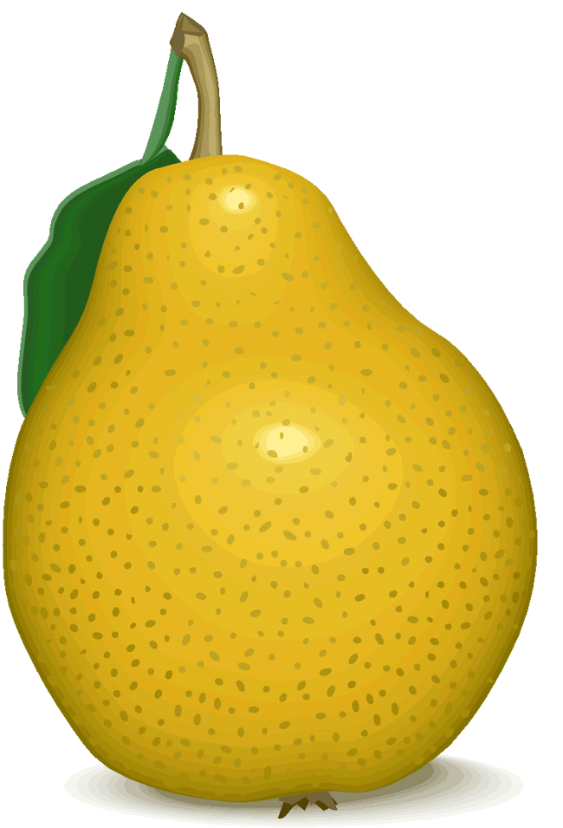
California’s Major Agricultural Commodities In Dollar Value
Milk & Cream……………$3,630,171,000
Grapes…………………….2,650,873,000
Nursery Products………...2,087,447,000
Lettuce…………………….1,370,004,000
Cattle & Calves…………..1,351,500,000
Hay………………………...1,020,510,000
Flowers & Foliage…………..998,459,000
Strawberries ……………..…841,031,000
Tomatoes……………………766,260,000
Almonds……………………..731,880,000

Slide 42
Careers Which Ag Area do they go in???
Pre-Rank/Post Which is your top 2? Change?
Botanist
Agronomist
Education and Extension Specialist
Farmer/Agricultural Manager
Certified Crop Advisor
Entomologist
Plant Scientist
Fishery Scientist
Tree Surgeon
Golf Course Superintendent
Florist

Slide 43
Flower Production from Field to You
Production Steps (2% of all Ag.)
Prepare land/soil
Plant seed
Irrigate (overhead) & Fertilizer
Cultivate (remove weeds)
Harvest
Package/Process
Ship to San Francisco Flower Market
Sell to Wholesale Florist
Sell to Retail Florist who makes it into arrangement
Sell to Consumer (tax is charged)

Slide 44
Floral 1 Career Practice Quiz
List 2 careers from the Service area.
What equipment might be Operated?
A harvester or Marketer are in this area?
Farmer or Rancher is in what area?
What area requires use of hand tools?
Wildlife Biologists are in what area?
Logger or Tree Surgeon are in what area?
List 3 careers in the area of Horticulture.

Slide 45
Unit 1 Quiz Careers Extra Credit
Write up on white board!!!
Who developed the square watermelon?
What are three things to consider when selecting a career?
List 3 ways to find out if you like a career option.
What careers make up 2% of all agriculture careers?

Slide 46
Weed Report Details
1 picture
1 paragraph description of the Plant (as to someone who has never seen it)
Scientific Name
Plant Classification (Perennial, Annual, Bulbs, etc)

Slide 47
Cover Letter
Floral 2 – Rough Draft Cover Letter
  Karen Ferrante
  Little Flower Shop
  84 West 11th Street
  Tracy, CA 95376
100% Guarantee of Satisfaction! Customer is Priority.
ROP - Regional Occupational Program – hands on Learning, practice and experience in class.
Resume Redone + Due and Typed on 9-9
Cover Letter Redone + Due & Typed 9-9

Slide 48
Merrill F. West Agriculture Department
Merrill F. West High School
1775 Lowell Avenue
Tracy, CA 95376
(209) 831-5430 Ext.3412
Fax: (209) 831-5433 mhepner@tusd.net
Letter Head Sample

Slide 49
8/27/15 Agenda
Warm UP – Steps in Production from farm to consumer
Flora I - Career Areas (Name Them)
Producer Notes
Quiz Review
Exit Ticket – Name 3 Ag Career Areas
  Floral II - Type final Resume & CL
  Fill in Record Book
Inventory Quiz #2 Tuesday
TA - Inventory Relabeled of All Cabinets – Same font

Slide 50
Compare 2 Careers
1. Describe how the careers are different.
2. Describe the skill sets needed for each occupation.
3. Compare the work environments of these occupations.
4. Describe the salary differences of these careers.
5. Describe the training and education needed for each career.
6. Explain why you would be more successful in the first career than the second occupations.

Slide 51
Career Presentation
1. Describe the career and skills needed.
2. What is work environments of this occupation?
3. Describe the salary.
4. Describe the training and education needed for the career.
5. What could you be doing now to prepare for it?

Slide 52
8//13 Agenda
Floral II – Resume past due
Rough Draft – Cover letter
Seeking a Sales Associate position
Check Web Site – Find out business motto
littleflowershop@sbcglobal.net
  Karen Ferrante, Owner
  Little Flower Shop
  84 West 11th Street,
  Tracy, CA 95376
Job Application - Due Friday
  No Abbreviations, Blue/Black Pen
  Sales Associate

Slide 53
8/28/15 Agenda
Floral I - Careers Quiz – Get out Paper and Writing tool
Warm Up –Jeopardy
Floral I – Unison part from memory
Text Book; Unit 1, Page 1-10
Define all jobs. (bold terms)
Include Fig. 1-2
Reference Text Book Unit 21 – pg 401-407 Bold Terms
  Define all terms listed below.
  Full Service, Specialty, Limited-Service, Flower Merchandiser, Free-Standing, Strip-Center, Shopping Mall, Business Complex, Downtown, Floral Dept.
Floral II – Finish Cover Letters Final Draft
EH – Warm Up and GTG
Job App
  No Abbreviations, Signed in Blue/Black Pen
  Sales associate position

Slide 54
8/31/15 Agenda
Floral I – Floral Shops
Warm Up – What is a Fishery Scientist???
Floral I – Unison Part from memory
Text Book; Unit 1, Page 1-10
Define all jobs. (bold terms)
Include Fig. 1-2
Reference Text Book Unit 21 – pg 401-407 Bold Terms
  Define all terms listed below.
  Full Service, Specialty, Limited-Service, Flower Merchandiser, Free-Standing, Strip-Center, Shopping Mall, Business Complex, Downtown, Floral Dept.
Floral II – Finish Cover Letters Final Draft
EH – Warm Up and GTG
Job App
  No Abbreviations, Signed in Blue/Black Pen
  Sales associate position

Slide 55
9/1/15 Agenda
All – Monday – No School
Floral I – Flower show
Warm Up –list 5 Floral Careers
Floral I – Text Book; Unit 1, Page 1-10 Define jobs in bold.
Include Fig. 1-2
Reference Text Book Unit 21 – pg. 401-407 Shops & Locations
  Define terms… Full Service, Specialty, Limited-Service, Flower Merchandiser, Free-Standing, Strip-Center, Shopping Mall, Business Complex, Downtown, Floral Dept.
Reference Text 408-414
Read descriptions of important shop elements & discuss
Floral shop Rough Draft Pair Share
  Swap you paragraph with a buddy at your table
  Make comments on buddy’s paper to help improved description
Floral II – Finish Resume and cover Letter

Slide 56
9/2/15 Agenda
All – Monday – No School
Floral I – Floral Shops
Floral I – Text Book; Unit 1, Page 1-10 Define jobs in bold.
Include Fig. 1-2
Reference Text Book Unit 21 – pg. 401-407 Shops & Locations
  Define terms… Full Service, Specialty, Limited-Service, Flower Merchandiser, Free-Standing, Strip-Center, Shopping Mall, Business Complex, Downtown, Floral Dept.
Warm UP – Shop Parts (Reference Text 408-414)
Read descriptions of important shop elements & discuss
Present Flower Shop Parts
Floral II – Record Book check tomorrow -
Inventory Sheets for all Cabinets
EH – Resume and Cover Letter

Slide 57
Warm – Up Matching Floral Shops
Full-service
Specialty
Flower Merchandisers
Stem Shops
Mass Market Shop
Cash and Carry
Free-Standing Flower Shop:
Strip-Center Flower Shop:
Shopping Mall:
Business Complex:
Downtown Location:
Floral Department:
Little Flower Shop
Flower Pavillion
Melissa’s
Savemart
Safeway
Raley’s
Costco

Slide 58
Flower Shop intro ideas
Floral I – Flower Shop Project
Journal Writing as a Warm Up
  What kind of shop would you like to open?
  What would be a cool location for a business?
  What would be a cool business/flower shop in our town?
  Best location for customers
  Types of services available
  Kinds of locations for cash and carry/floral Department.
  Personal Qualities you would look for in a person to be your delivery person?

Slide 59
Floral Shop Parts
Visual Merchandising
Vignette
Window Display
In-Store Display
Service Area
Work Area
Storage
Refrigeration
Operational Considerations
9. Employees and Responsibilities
10. Computer Station
11. Marketing
12. Water Source

Slide 60
9/4/15 Agenda
Floral I – Careers – Note Check – Tuesday
  Organize Notes for
  Warm Up –list 5 Careers in the Floral Shop
Word of the Day - Delivery
Floral I – Text Book; Unit 1, Page 1-10 Define jobs in bold.
Include Fig. 1-2
Reference Text Book Unit 21 – pg. 401-407 Shops & Locations
  Define terms… Full Service, Specialty, Limited-Service, Flower Merchandiser, Free-Standing, Strip-Center, Shopping Mall, Business Complex, Downtown, Floral Dept.
Reference Text 408-414, Present Flower Shop Parts
Floral II – Job Application Due
Tuesday - Record Book Placement Agreement
EH – Outside; Cuttings in Perlite, Weeds/ Mulch
Resume Cover Letter and Applications Past due

Slide 61
Period 1 Word of the Day - Delivery
Delivery – the best delivery I ever got was a large arm bouquet of roses. It was a present from my husband. The flowers were bright salmon color. I never saw a color like this before that I would say I liked. It was orange but pink and totally beautiful. I would say that up to this point I was not a fan of the color salmon. I would never have purchased an outfit or a pair of shoes in this color. I have no other item in my life that was even remotely close to that color. I did not, at the point in my life even like the taste of the fish that has that name. I was against salmon in all of it forms until that day. I would have not ever considered that color a valuable member of the color world. Maybe it was the thought behind it or the fact that it was a delivery special for me, but I loved that bouquet of salmon roses.
That delivery of roses turned out to be a great project for my students as well. We did not have the money during those years to purchase a lot of extra flowers. So those beautiful roses that were delivered that day, became a class project for my floral II students. They were so excited to use a rich product like that. Each rose was carefully stripped, cut and placed in an arrangement as if it was the most important arrangement they would ever do. Two periods got to enjoy that learning process and I and all my other periods got to enjoy a wonderful display for the remainder of the day. Sometimes the best gift is a gift you were not expecting, and that day the gift was amazing. My students and I both got a gift.
Red Roses in our culture say love, but other colors are sometimes forgotten. Just like in life colors can really make you stop and think.

Slide 62
Period 5 Word of the Day - Delivery
Delivery - to make a delivery is a fun thing. You might be bummed out from your work or tired even from a long hours of boring work but when you make a delivery to anyone for some thing you are making them happy. When you make a delivery the person is usually surprised and it is usually a good surprise. The best delivery that I got was a total surprise and from someone I love. The best part of making the delivery is the smile that the person gets… even if they don’t know who it is from or why, there is a smile. Deliveries don’t happen so often that you get use to them. I hope that no human ever gets tired of getting a delivery and I hope that a human always appreciates the treat of it and the person making the delivery. You should tip the person that is making the delivery because they are making your day.
Delivery's are not always fun for the person making the delivery. If there is a problem for the driver, they are required to fix the problem and the person receiving the delivery should not ever be able to tell there was a problem. For example a piece could have gotten dropped or nocked over. It is the drivers job to fix the problem and make the piece look like new. In the fast paced world of floral delivery, there is no time to go back to the shop to fix something. The driver should be trained in fixing items and have additional materials and tools with them in the case of a large order. The cost of the time and transportation to come back to the shop is a detriment to the shop income and livelihood.
The worst delivery is the kind when you can’t find the place you are going and you have a small window of time to meet the customer. Sometimes this happens because you are behind in your schedule due to getting lost or if something got messed up. I really don’t like it when I am late and I promised the person I would be there at a certain time and can not hold up my end of the deal.

Slide 63
Period 5 Word of the Day - Delivery
Delivery – when I think of this word I want to go and give someone a delivery of something nice. I got a ‘Edible Arrangement’ delivery this past year and it was awesome. I was totally surprised and delighted. It was beautiful to look at and wonderful to enjoy. The fruit was so fresh and cut so perfectly. The colors were amazing and the idea behind the arrangement is brilliant. Who ever thought of such an idea is awesome. I saved every bit of the materials that went in to constructing the arrangement because I hope to rebuild it some day. The best part of the whole piece was that it was so simple but held up so well. I think that there is a special air or filter in the plastic that keeps it fresh. The company must have a patent or trade secrets because I requested a demonstration for my classroom one time and they refused to come and show my students eve n if I paid for the materials.

Slide 64
Period 6 Word of the Day - Delivery
Delivery – I have always wanted to be a delivery person because it would be fun to bring people things that they wanted or would be fun to receive. I always thought that getting mail when I was younger was great. It was great because it was always fun mail. Now that I am an adult, I don’t love the mail so much and it is hardly ever fun. Why? Because it is bills and paper that have to be dealt with. I have a stack at home right now that I don’t look forward to doing tonight. I start by opening all the mail and sorting it into piles of things I have to do with it. They I take on the task assigned. Only at Christmas time or birthday do I get mail that is good mail and fun to open. Sometimes I don’t’ open good mail for a while… because I know it is going to be good and I want to save it and savor it for a long time. I imagine what is fun inside just like it is a present. Now that I am older the only kind of mail that I look forward to is the good kind.
The good kind of mail is in short supply and I think that I should be part of the change that is needed to bring good mail back. Sometimes I smile when I have an idea for sending someone a good piece of mail. I try to imagine how they will feel when they get a good piece of mail and that I am connected to that. I currently have a good piece of mail sitting on my desk at home that I am almost done with and ready to mail. It is a note to a friend who has just lost a family member. I know that this is a sad piece of mail for them, but I hope that the words I put into the note will make the message better. I am sad for their loss and wish I could help make them feel better. That is, after all the good part of good mail, making someone feel better, or loved, or appreciated, or just remembered.
I think that mail is good because it can be kept and cherished. I never go back and read old email, I just keep it to prove some work got done. However, I do go back and read old cards and letters.

Slide 65
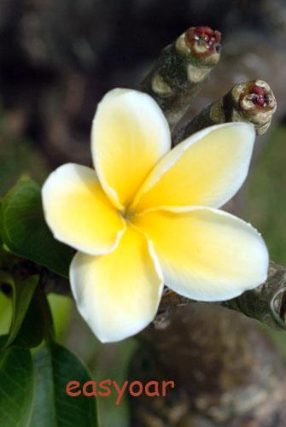
Description
Juliettes' Jewels of Flowers, is my full service flower shop. We specialize in arranging flowers, planning weddings, and other party events. In addition, we sell party balloons, gifts, gift cards, cakes, and more. We sell flowers from around the world, such as; Tiares from Tahiti, Hibiscus from the Pacific islands associated with the Hawaiian islands, Mexican hat flower garden plant, locations to serve you; Stockton, San Francisco, and our main shop in Fremont, 1821 Beshinin Onem drive, 94539.
We have 18 considerate employees that will help you with your needs. Staff is on the floor in every area to assist you; with cards, candy, balloons, gifts, flowers, designing, and wedding planning. We take orders, walk-ins, and for large events, consultation appointments. The shop is open from 10 AM. - 7PM. Monday - Friday and 10 AM. - 4PM. on Saturdays closed on Sundays. So come to Juliettes’ Jewels of Flowers and we will make you shine!

Slide 66
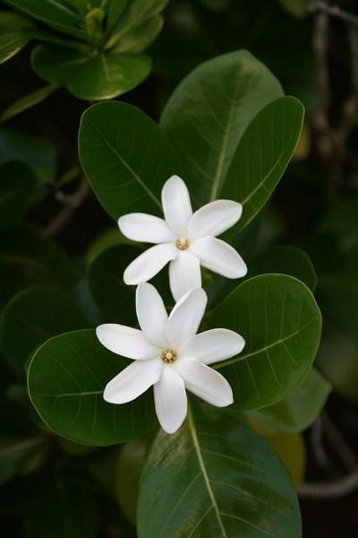
Juliettes Jewels Of Flowers
We’ll make you shine
at our
Full Service Shop
located in Stockton, San Francisco, main shop at 1821 Beshinin Onem Fremont CA. 94539
Stockton – (209) 346-7832
San Francisco – (415) 640-4867
Fremont – (510) 760-6594

Slide 68
The Shop is
40 x 30
Legend
Doors
Balloons Area
Break Room
Swinging doors
Gift Shop
Front Office/ Desk
Windows
Cards Area
Womens Bathroom
Window Display
Designing Area
Mens Bathroom
Planning Area
Fridge
Working table
Worker Area
Water Area
Cash register
Flower Area

Slide 69
Flower Shop Floor Plan
These are the must have items in the shop.
Fridge
Sink
Draw an edge of Shop/not Edge of paper
Drawing to Scale and/or Legend
Client Area
Employ Station or Work Areas
Options: - Balloons
- Gift Wrap and Delivery
- Plants
- Cashier
- Window Displays
-Vignette

Slide 70
9/8/15 Agenda
Floral I - Careers Note Check
  Power Point Notes (Show me the Money)
  Floral Career Textbook Notes(reference and small text)
  Flower Shop Rough draft Description & reviews
  Nursery Text Book Career Facts (2 each for 15 careers & Flower Production List
  Highlight Notes
Warm Up –list 5 types of Floral Shops
Floral I – Text Book; Unit 1, Page 1-10 Define jobs in bold.
Include Fig. 1-2
Reference Text Book Unit 21 – pg. 401-407 Shops & Locations
  Define terms… Full Service, Specialty, Limited-Service, Flower Merchandiser, Free-Standing, Strip-Center, Shopping Mall, Business Complex, Downtown, Floral Dept.
Reference Text 408-414, Present Flower Shop Parts
Flower Shop Rubric: Floor Plan
Floral II – Record Book check tomorrow -
Inventory Sheets for all Cabinets
EH – Check Name Quiz, Collect Apps & GTG

Slide 71
9/9/15 Agenda
Floral I – Flower Shop Rubric: Stapled on Top
  Write note at bottom about email.
  Rubric on Top
  Description
  Business Card/Letter Head
  Shop Sign
  Floor Plan
  Present Flower Shop Projects for extra points
Steps of Flower Production list & top Commodities
Organize Notes for binder check
  Power Point Notes (show me the money)
  Floral Career Textbook Notes(reference and small text)
  Nursery, landscape, floral career – 2 facts each
  Rough draft Description & reviews
  Flower Production List
  Highlight Notes
Floral 2 – Garden
Record Book ;Placement agreements

Slide 72
Right Brain or Right Foot??
How Smart is Your Right Foot?
      While sitting at your desk , lift your right foot off the floor and make clockwise circles
      Now, while doing this, draw the number 6 in the air with your right hand.
      3. What did your foot do???? This request confuses your mind. Keep trying over and over again to see if you can outsmart your foot.

Slide 73
Floral Shops
Full-service – All services; events, gifts, plants & flowers
Specialty– Just Weddings or Parties (Large Events)
Limited-Service /Carriage Trade Shop – Elite clientele
Flower Merchandisers: Stem Shops - Mass Market Shop
Mass Market Shop/ Cash and Carry
Studio Operation – usually in a business complex
Wholesale Florists – No store front, phone order & delivery
Locations
Free-Standing Flower Shop: Single Building with parking lot
Strip-Center Flower Shop: Multiple business with 1 lot
Shopping Mall: Many Shops Enclosed in 1 large building – 1 lot
Business Complex: High rise building
Downtown Location: In a building in the cities downtown
Floral Department: A smaller part of a large retail establishment

Slide 74
Tape Wire Lesson
Floral I Objective – Students will….
  Safe Use of Tape and Wire.
  Tape Wire to hold materials together.
  Make a Tuzzy Muzzy in class.
Tape Wire – Use, Tools and Safety
    Cover Wire
    Extend Items
    Hold things together
    Change shape of things
    Samples
    Bring Candy on tomorrow

Slide 75
Floral 1 Career Quiz
List 2 careers from the Ag Horticulture area.
Logger or Tree Surgeon are in what Ag Career area?
List 2 different kinds of Flower Shops.
List 2 locations a Flower Shop might be located.
List 2 careers in the Floral Shop.

Slide 76
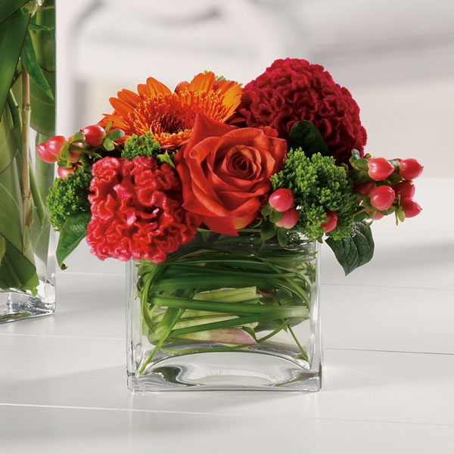
Flowers of the Month
Tentative Delivery Dates
September 13
October 18
November 8
December 6
January 10
February 7
March 13
April 17
May 22
  *Delivered To West High Class Rooms on same day.
  *Secret Pal options available.
$ 75.00 per year
$ 40.00 per Semester
Contact mhepner@tusd.net to order today

Slide 77
9/5-6/13 Agenda
Floral I - Career Unit – My Flower Shop
Warm up – 5 things you need in your shop floor plan
Flower Shop Description – Final
Business Card/Letter Head - final
Shop Sign – final
Floor Plan - rough
Floral II - Finish new Job application, resume, cover letter, reference
HMF
Placement Agreement

Slide 78
Record Book Placement Agreement
#5 Students Will; Clean Shop, Process Flowers, Design Arrangements, Deliver Arrangements, Complete Advertising & Sales for Flowers by the Month.
#6 Teacher Will; Train Students, Provide Materials, Arrange Sales, Consultation Presentations, Career Experience, & 2 Arrangements Per year.
#7 Students Will Be; Punctual, Follow Directions, Practice Skills, & Create A Portfolio of Work.

Slide 79
Welcome to Back to School Night
Mrs. Hepner 's Floriculture Class
Introduction
Agenda & Syllabus Review
Grades Posted
Upcoming FFA Events
  9-14 FFA Meeting in P-12 @ 3:15pm
  9-29 Delta Cal Opening Closing contest
  9-30 Kid in a Box @ St. Bernard's
  10-5 State FFA Officer Visit
  10-6 Greenhand Conference
  Poinsettia & See’s Pre-Sale in November

Slide 80
9/10/13 Agenda
Floral I – Flower Shop Project Due Staple & turn in
  Present Flower Shop Projects for extra points
Cotton Video
Steps of Flower Production list & top Commodities
Organize Notes for Quiz - tomorrow
  Power Point Notes (show me the money)
  Floral Career Textbook Notes(reference and small text)
  Rough draft Description & reviews
  Flower Production List
  Highlight Notes
Floral 2 – Quick Write –write about trials or struggles that you have faced in life.
Record Book ;Placement agreements

Slide 81
Not used 2012 Agenda
All – Minimum Day Monday (12:16)
Floral I - Career Presentations (individual);
Presenters; Pick Poster, Read Information & Summarize
  Description
  Education
  What can you do now to prepare for this career?
  EC - New Horizon - Article Report
Floral II – Record Book - Journal Pages
Review Job Applications
Flowers by the Month Posters - Design
Work Interest - ReviewWork Interest
  Fill in Worksheet and calculate
  Presentation tomorrow; top two areas, 3 career choices, did it turn out like you thought?
  Presentation tomorrow; top two areas, 3 career choices, did it turn out like you thought?

Slide 82
9/11/13 Agenda
Floral I –Career Jeopardy
Clear desk
Get out writing tool and SSR Book & Take Quiz
Turn in Organized Notes into basket
  Power Point Notes (show me the money)
  Floral Career Textbook Notes(reference and small text)
  Rough draft Description & reviews
  Flower Production List
  Highlight Notes
Floral 2 – Process Flowers
Sample flower and FBTM prep
Record Book ;Placement agreements

Slide 83
  Floral I – Answer the following questions.
  What do you write on the pass to use the bathroom?
  List one ESLR and one Pillar of Character.

Slide 84
Agenda
All – Back to School Night Tonight!
Floral 1 – Ag commodities
Group Presentation - Notes
  List commodities # 1 county for production
  Nutrition Information – 1 fact
Floral 2 – Resume & Cover Letter due Friday 9-9
Make Wedding Flowers

Slide 85
Floral I Extra Credit
List 1 ESLRS.
List 1 Character Pillar.
When is the first FFA Meeting?
List 1 item that can get recycled in Mrs. Hepner’s classroom.
That do I expect you to do when you need to use the restroom?
What is the Agenda Binder for?

Slide 86
Did not use in 2014 ESLRs – Mini Poster (not in 2013)
ESLRS/ Character Presentation (did not do this for 2012)
- Select Item as a table
-Define ESLRS/Character/Mission/Vision Belief
- Create Mini Poster
- Poster should be Colorful
- Paraphrase or summarize Words to Explain
- Present Mini Poster to class
- Posters will be displayed @ Back to School
Night (September 1st)

Slide 87
Ivy Cutting Details
1 cutting method
4 different cutting media treatments
1 Perlite – What is it?
1 Perlite with Rooting Hormone
1 Soil in Six Packs
1 Soil in Six Packs with Rooting Hormone
Plant Classification (Perennial, Annual, Bulbs, etc)

Slide 88
Did not use in 2014 Funny Story (Mad-lib or Adventure Style)
Plan an Adventure – trip across many obstacles.
Draw a Map of adventure.
Ideas; follow a cartoon, comic, movie or show that you know.
Use 15 Names from your class.
Remember to be appropriate and respectful of name use.
I paragraph minimum.
Funny adjectives or descriptors

